Slide 1
Network Analysis of Resting-State Functional MRI
Kun Peng, Jules Zou, Yan Zhang

Slide 2
Background
Functional connectivity in the brain
Reflects synchronized activity between brain regions
Provides insights into neural networks and cognitive functions
Resting-state fMRI (rs-fMRI)
Standard tool for assessing intrinsic brain networks
Captures spontaneous fluctuations in BOLD signals
Helps observe baseline neural activity and brain organization at rest

Slide 3
Research Question
What are the network characteristics of brain functional connectivity in resting state?
How do these characteristics reveal patterns of connectivity and network organization?
How do network metrics characterize the brain's functional connectivity?

Slide 4
Objective
Construct functional brain connectivity networks
Investigate functional connectivity patterns and network characteristics in the resting brain
Explore and experiment on various tools and methods in the field of neuroimaging

Slide 5
Materials
This study includes resting-state fMRI data from 33 healthy participants. Participants underwent an anatomical scan and a 10-minute resting-state fMRI session while at rest.
Blood oxygenation level-dependent (BOLD) fMRI data were collected at a 3T scanner with a resolution of 80 × 80 × 35 voxels and approximately 286 time points per scan.
Each slice has an 80 x 80 grid of small 3D units(3mm * 3mm in slice, 4mm between slices), capturing average signal intensity in tiny brain regions. The 35 slices cover the brain from bottom to top, allowing detailed observation of activity across different areas over time.

Slide 6
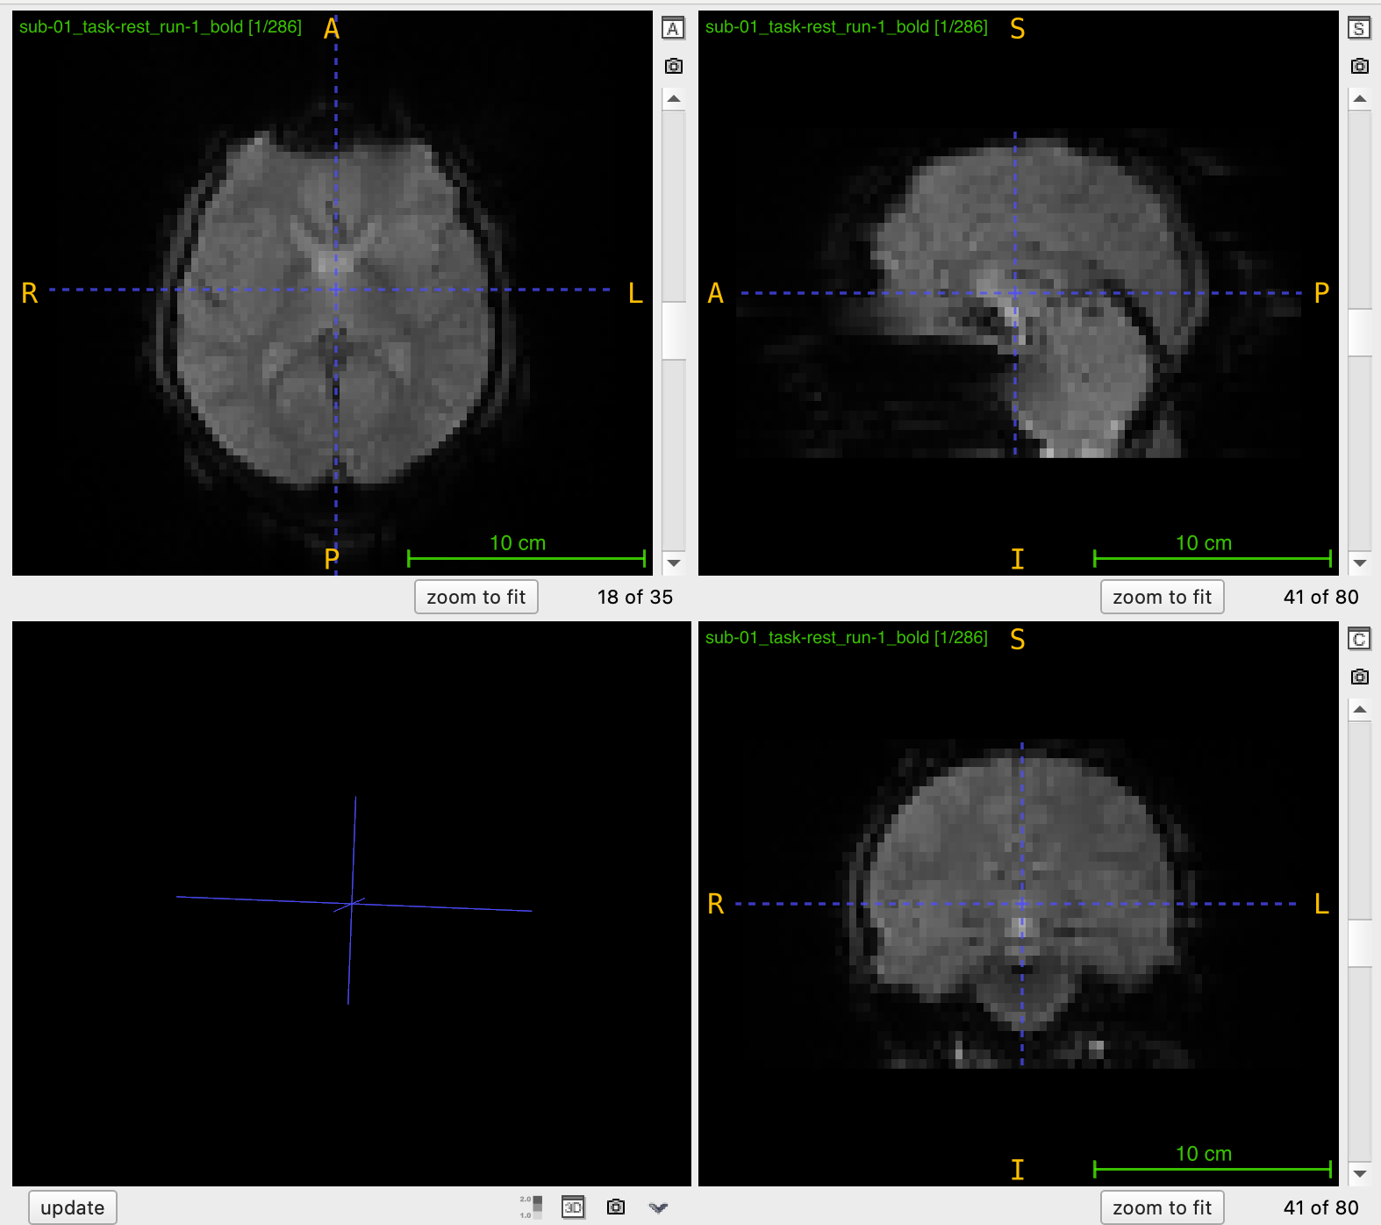
Materials
axial view
a horizontal slice from the top
sagittal view
a side view along the midline of the brain
coronal view
a front-to-back slice

Slide 7
Methods
Workflow
Data Preprocessing
Performing spatial normalization to MNI space, saptial smoothing
Define Regions of Interest (ROIs) & Extract Time Series
Choose a brain atlas, transform the data to atlas space and segment the brain into predefined regions for analysis (may compare different atlases)
Compute Functional Connectivity Matrix
Calculate the correlation between time series of each pair of ROIs to construct connectivity matrix

Slide 8
Methods
Workflow
Threshold and Binarize
Apply a threshold to the connectivity matrix to create a binary matrix, which helps visualize and simplify the network structure. We may compare different thresholds to the weighted and fully-connected network
Network Construction & Analysis
Use the connectivity matrix to construct the network and analyze

Slide 9
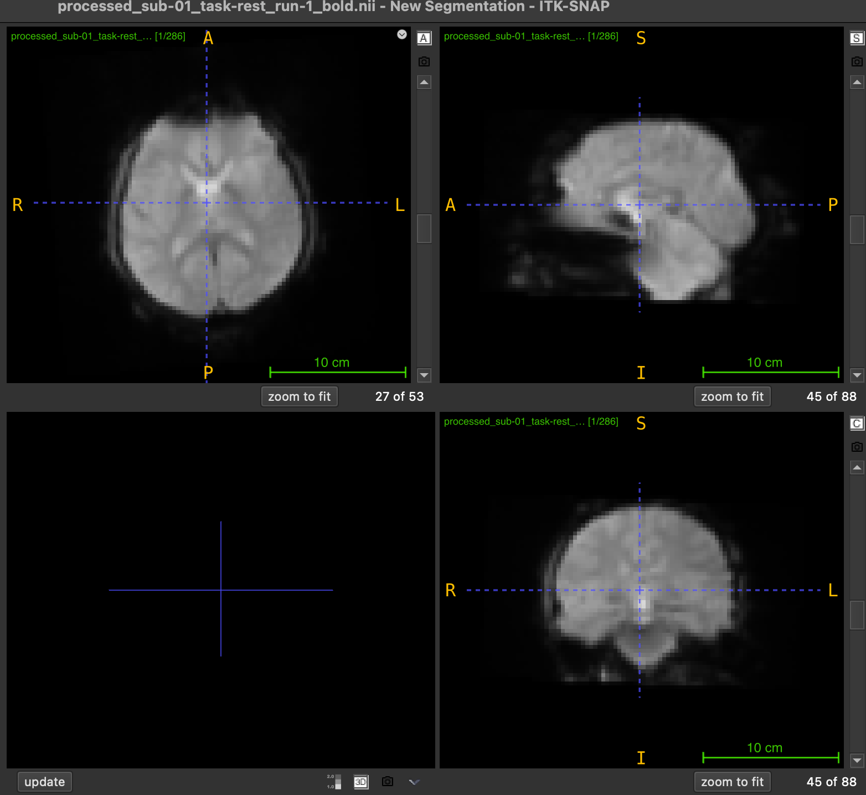
Methods
Data Preprocessing
Spatial Normalization to MNI Space: To standardize the data, we align each scan to the standard MNI (Montreal Neurological Institute) space with a 3mm voxel size.
Spatial Smoothing: To reduce noise and improve signal quality, we apply a Gaussian smoothing filter with a 4mm full-width half-maximum (FWHM)
Before
After

Slide 10
Methods
Define Regions of Interest (ROIs) & Extract Time Series
Break down the brain into specific anatomical areas for more focused study
So far, we use the AAL (Automated Anatomical Labeling) atlas to define our ROIs. This atlas segments the brain into about 90 regions.
Compute Functional Connectivity Matrix
For each pair of ROIs, we compute the Pearson correlation between their time series data
The resulting matrix is symmetric and square—with each row and column representing one ROI.

Slide 11
Methods
Threshold and Binarize
We applied a threshold of 0.1 to the functional connectivity matrix, meaning that only connections with a correlation of 0.1 or higher are retained.
We binarize the matrix, converting all remaining connections to 1.
Network Construction & Analysis
So far, we have constructed separate networks for each of the 33 participants.
Nodes: predefined Regions of Interest (ROIs) in the brain
Edges: Indicate strong connections (correlations) between these regions

Slide 12
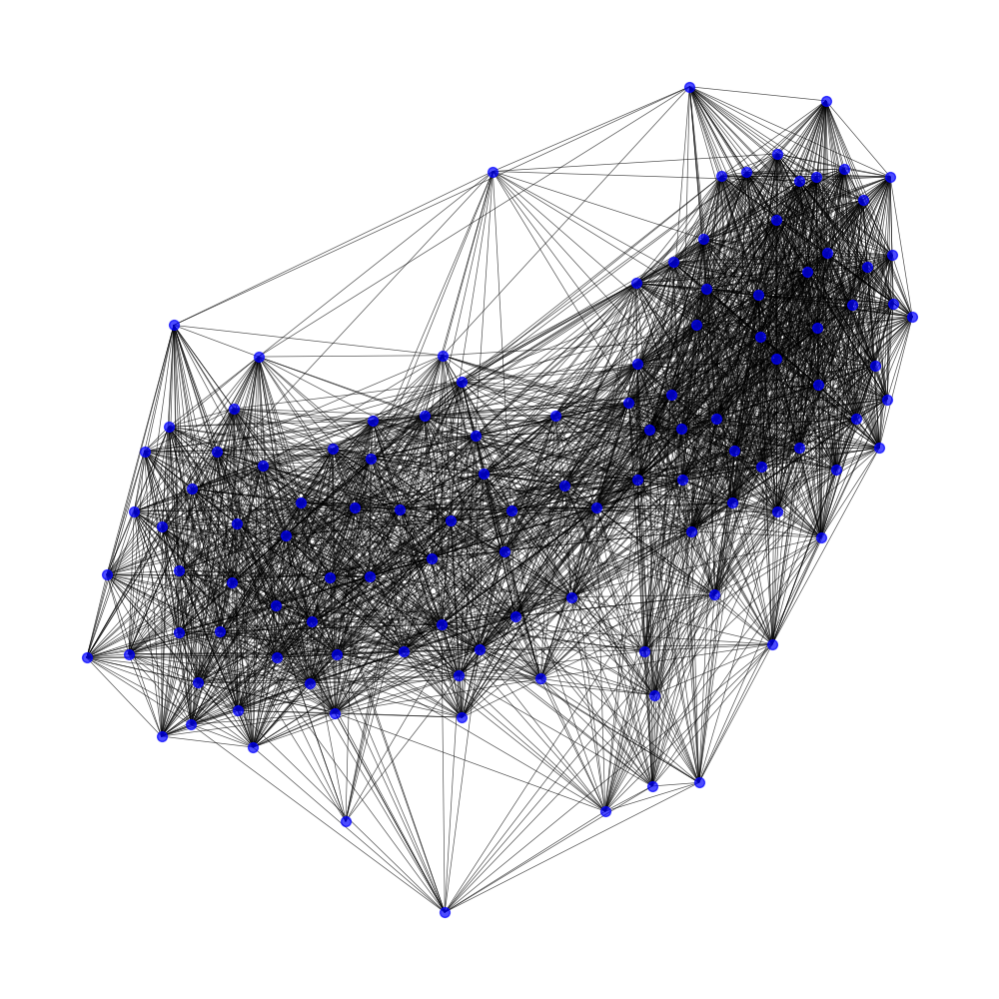
Methods
Example of networks
Undirected & One mode network
Many edges: indicating a high level of connectivity between brain regions at rest
Dense structure: various brain regions remain functionally connected even without performing a task
Network of participant 5

Slide 13
Network Metrics
Degree: a high degree indicates that a brain region is highly connected to other regions, possibly acting as a hub for information flow within the brain.
Clustering Coefficient: represents the extent to which a node’s neighbors are also connected to each other, forming a “cluster.” A high clustering coefficient in brain networks suggests local integration and specialized processing within specific brain regions, often seen in functional modules.

Slide 14
Network Metrics
Characteristic Path Length (average shortest path between nodes):This is the average shortest path between all pairs of nodes in the network. It reflects the efficiency of information transfer across the entire network. A shorter characteristic path length indicates that information can travel quickly across brain regions.
Small-World Properties: Small-world networks are characterized by a high clustering coefficient and a short characteristic path length. This combination enables both local specialization and efficient global integration, which is a prominent feature in brain networks and supports both segregated and integrated information processing.

Slide 15
Future Work
Combine the data from all 33 participants into a single network and create a group-level network that represents the shared functional connectivity structure in the resting brain.
Apply network metrics to analyze the structural properties of the group-level network.
Try other brain atlas and compare the results.
If possible, integrate fMRI and EEG data to see combined insights.

Slide 16
Thanks!

